Slide 1
LAN Concepts and Components
Version A.01
H3065S Module 1 Slides

Slide 2
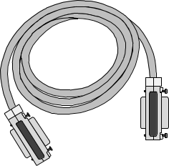



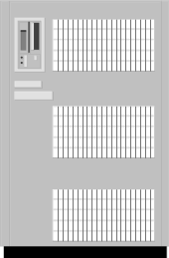


What Is a Local Area Network (LAN)?
Type of Connection Max Length
SCSI Bus 5 m
Local area network (LAN) 5 km
Wide area network (WAN) 500 km
a6731

Slide 3

The OSI Model in a Nutshell
7 Application How is data created and used?
6 Presentation How is the data represented to the application?
Is the data in EBCDIC or ASCII format?
5 Session How does an application initiate a connection?
How does an application actually transmit/receive data?
How does an application know data has been received?
4 Transport Should the receiver acknowledge receipt of a packet?
How should the acknowledgement be handled?
Which process should receive the data?
3 Network How is data routed between networks?
2 Data link How do I know when its my turn to transmit?
How do I know which data is for me?
How are collisions handled?
1 Physical What kinds of cabling are supported?
What kinds of connectors are supported?
What’s the longest supported cable segment?
a6732

Slide 4
Media Access Control (MAC) Addresses
A MAC address uniquely identifies a LAN card.
MAC addresses identify a frame’s destination.
Frames contain source and destination MAC addresses.
Hosts accept frames destined for their MAC address.
Hosts ignore frames destined for other MAC addresses.
MAC address structure
A MAC adress is a unique 48-bit hex number assigned to
each network card by the card manufacturer.
Example:
0x 0060B0 7ef226
Following no. Card manufacturer’s Unique card
is in hex… ID number ID number
a6733

Slide 5
Internet Protocol (IP) Addresses
IP address purpose
IP addresses allow related nodes on a physical network to be logically grouped together.
Related nodes are grouped by an administrator by IP network numbers.
IP addresses uniquely identify a device within an IP network.
IP address structure
Each IP address contains two parts:
• The network portion specifies the address of the network
containing the system.
• The host portion specifies the address of the host on the network.
Example :
156 . 153 . 194 . 170
Network
Portion
Host
Portion
a6734

Slide 6
Three Classes of IP Addresses
Three classes of network address are available.
Network class is determined by number of network bits.
Class A
Class B
Class C
0
1 0
1 1 0
a6735

Slide 7
IP Addresses and Network Routes
Mickie
128.1.1.3
Minnie
128.1.1.2
128.1 (Officenet)
Router
192.1.2 (Factorynet)
Cleo
192.1.2.3
Clara
192.1.2.2
a6736

Slide 8
Choosing an IP Address
General Restrictions
Each IP address must be unique.
The first IP address octet must be in range 2–224 (except 127).
Public Internet IP addresses must be ordered through :
http://www.arin.net (North/South America)
http://apnic.net (Asia/Pacific)
http://ripe.net (Europe)
Special Addresses
loopback address (127.0.0.1)
broadcast address
generic network address
a6737

Slide 9
IP Addresses — Examples
Sample Host IP Class Network Address Host Address Broadcast Loopback Addr
192.66.123.4
148.162.12.14
9.12.36.1
163.128.192.9
123.45.65.23
a6738

Slide 10
Hostnames
Hostnames are user-friendly “nicknames” corresponding to an IP address. Hostnames are made up of letters or numbers (maximum of 8 characters).
Example hostnames include:
tom server1
accounts mailsrvr
Hostnames are defined in /etc/hosts (or DNS or NIS).
Sample /etc/hosts file:
Hostnames are always resolved to IP addresses before a packet is sent.
Examples:
telnet minnie resolves to telnet 128.1.1.2
ftp mickie resolves to ftp 128.1.1.3
128.1.1.2 minnie
128.1.1.3 mickie
. . .
a6739

Slide 11
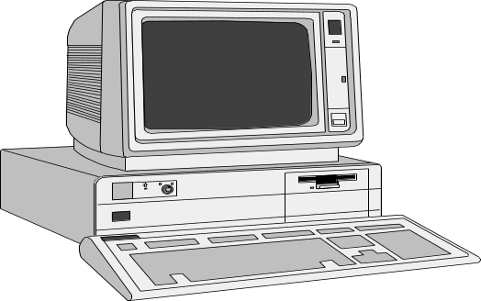
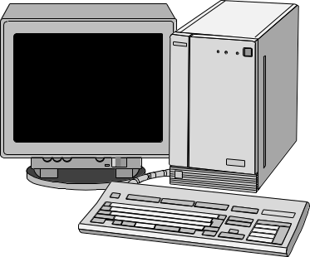
Converting IP Addresses to
MAC Addresses
Network Packet
Destination MAC Address
080009-23EF45
Source MAC Address
080009-123456
Data
xxxxxxx
Mickie
Minnie
$ ping minnie
080009-23EF45
080009-123456
/etc/hosts
Arp cache (memory resident)
128.1.1.2 minnie
128.1.1.3 mickie
128.1.1.4 pluto
128.1.1.4 080009-1A23C4
128.1.1.3 080009-123456
128.1.1.2 080009-23EF45
Example: system mickie pings system minnie
1. Resolve hostname minnie to an IP address.
2. Look up the MAC address in the ARP cache
corresponding to minnie’s IP address.
3. Send the packet to minnie’s MAC address.
a67310

Slide 12
Populating the ARP Cache
6
3
Broadcast
Packet
4
Arp cache
2
128.1.1.4 080009-1A23C4
128.1.1.5 080009-234ABC
128.1.1.2 incomplete
clive
128.1.1.4
cleo
128.1.1.5
minnie
128.1.1.2
128.1.1.2 080009-23EF45
mickie
128.1.1.3
5
1
$ ping minnie
Example:
1. System mickie pings system minnie. System resolves minnie’s IP address.
2. Search for minnie’s IP in the arp cache — the IP address not found in ARP cache.
3. Send arp broadcast on local network to find specified IP address.
4. System with specified IP address responds with packet containing its MAC.
5. The MAC address and corresponding IP address are added to the ARP cache.
6. The packet specifically addressed to minnie’s MAC address is sent.
a67311

Slide 13
Putting It All Together
Is the
destination a hostname
or an IP address?
hostname
Resolve hostname
to corresponding
IP address.
Is the
destination IP address
found in ARP cache?
IP address
No
Yes
Look for the destination
IP address in routing table.
Send a broadcast requesting
the MAC for the destination IP.
Use the MAC address found
in ARP cache as the
destination MAC.
Is the
destination on the
local network?
Destination machine responds
with its MAC address.
Yes, on local
network
No
Record the found MAC address
in the ARP cache for later reference.
Send packet to router
to be forwarded to
destination host.
Send the packet out on the wire
with the source and destination
MAC and IP addresses.
a67312

Slide 14
Managing Packet Flow with TCP
Retransmit
4
3
Send
Packet
2
3
2
1
1
3
2
Data Packets
Acknowledgements
1
5
1
2
3
2
1
2
3
Open
Close
clive
128.1.1.4
cleo
128.1.1.5
6
mickie
128.1.1.3
Segment
Data
Reassemble
minnie
128.1.1.2
Sending a packet with TCP:
1. Open connection to remote node.
2. Segment data into “datagram” packets.
3. Send datagrams to destination node.
4. If there is no acknowledgement, retransmit!
5. Close connection after all datagrams are received.
6. Receiver node reassembles datagrams into proper order.
a67313

Slide 15
Managing Packet Flow with UDP
2
2
1
1
1
2
clive
128.1.1.4
cleo
128.1.1.5
1
3
mickie
128.1.1.3
minnie
128.1.1.2
Sending a packet with UDP:
1. Packets cannot be segmented or streamed; a packet is always sent as a single message.
2. No connection is opened with the node; the packet is simply sent to the node.
3. No acknowledgement is sent back to the original sender.
Since the original sender never knows if packet is received, sender never retransmits.
The receiver doesn’t know if it received all of the intended packets.
With UDP, the application is responsible for ensuring data transmission is complete.
a67314

Slide 16
Sending Data to Applications via Ports
To: port 23
To: port 21
To: port 512
Network Subsystem
clive
128.1.1.4
cleo
128.1.1.5
minnie
128.1.1.2
telnetd
ftpd
rlogind
port 23
port 21
port 512
Mickie 128.1.1.3
$ telnet mickie
$ ftp mickie
$ rlogin mickie
Problem: Who gets the data?
Thousands of packets arrive every minute on the LAN interface card.
How does the network subsystem know to which application to deliver the network packets?
Solution: Assign each application a unique port number.
When each packet is sent, a port number will be included in the packet.
The port numbers identify which network application is to receive the packet.
a67315

Slide 17
Managing Ports with Sockets
To: port 23
To: port 23
To: port 23
Network Subsystem
clive
128.1.1.4
cleo
128.1.1.5
minnie
128.1.1.2
telnetd
ftpd
rlogind
telnetd
ftpd
telnetd
$ telnet mickie
$ telnet mickie
$ telnet mickie
$ ftp mickie
$ ftp mickie
$ rlogin mickie
Mickie 128.1.1.3
Problem: Which network application gets the data when multiple instances are present?
Multiple clients can be executing the same network application (such as, ftp on cleo and minnie).
Multiple instances of the network application can be running on the same client (such as, telnet on clive).
Solution: Create a unique socket for each process which runs a network application.
A socket is a port number combined with a node’s IP address.
A socket connection is the coupling of a client socket number with a server socket number.
a6981

Slide 18
More on Socket Connections
To: port 23
To: port 23
Network Subsystem
telnet
128.1.1.4.1001
telnet
128.1.1.4.1002
telnetd
128.1.1.3.23
telnetd
128.1.1.3.23
Clive 128.1.1.4
Mickie 128.1.1.3
Socket = IP Addr + Port No.
128.1.1.4 . 1001
$ telnet mickie
Socket = IP Addr + Port No.
128.1.1.3 . 23
128.1.1.3 . 23
128.1.1.4 . 1002
$ telnet mickie
Socket Connection
Socket
Communications between two processes
over the network are uniquely defined by
their socket connection.
Socket
a67317

Slide 19

Revisiting the OSI Model
7 Application Creates/receives the data.
6 Presentation Determines the format in which to represent the data.
Possible choices are EBCDIC or ASCII format.
5 Session Establishes a unique communication path between client/server.
Sockets are used to communicate between two systems.
A socket is an IP address plus a port number.
4 Transport TCP requires that a socket connection be established; UDP does not.
TCP requires packets be acknowledged; UDP does not.
TCP is streams-based; UDP is message-based.
3 Network IP addresses define a system’s network and host number.
2 Data link MAC addresses uniquely identify a LAN card.
Ultimately, packets are sent from one MAC address to another.
ARP caches map IP addresses to MAC addresses.
1 Physical The type of media used to connect the machines together.
The type of cabling used for the network.
a6982

